Slide 1
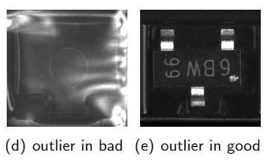
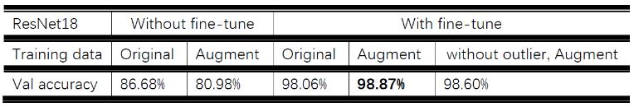
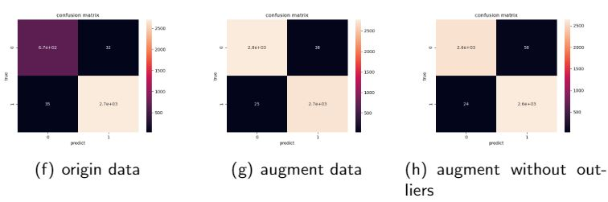
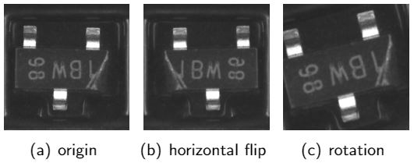
MATH 6380P Final Project: Kaggle in-class Contest: Nexperia Image Classication II
FAN Ganghua gfanab@connect.ust.hk
Department of Mathematics
1. Introduction
3. Anomaly Detection
5. Analysis
Nexperia provided a dataset for Kaggle in-class contest that aims to classify images of semiconductor devices into two main classes, good and defect. The Nexperia image dataset in the Kaggle contest contain 34459 train images (27420 good and 7039 bad) and 3830 test images with similar good-to-bad ratio.
This work presents using pre-trained Resnet18 on the images of semiconductors for image classification. Since the good images are about 4 times of defect images, I augment the bad samples by simple image transformations to balance the two classes. Then the one-class-SVM is used to remove the influence of anomalies on the training set.
Target: eliminate the effect noisy labels on deep learning models
Method: Scattering Network to extract features + one-class-SVM to detect outliers
Reason: one-class-SVM is unsupervised, suitable for high dimensional anomaly detection
How:Scattering2D(J=2,L=8)+svm.OneClassSVM(nu=0.01,kernel='rbf',gamma='auto’)
Performance Metric: Confusion Matrix
Fine-tune can extremely improve the accuracy of pre-trained deep neural network.
Data augmentation can benefit the performance of ResNet18 with fine-tune, but not much. The original data performs better that I have thought, maybe the imbalance of this dataset(4:1) is not that horrible to be the dominant condition.
The experiment of anomaly detection does find some outliers, but "augmentation after deleting outliers" has lower accuracy than "augmentation only" one. I think deleting outliers may lead to lose some information and the anomaly detection process can also introduce errors.
6. Conclusion and Future Work
This work uses pre-trained ResNet18 to classify semiconductors into good class and defect class. I perform experiments on original data, augment data and outlier detected data to find the effect of imbalance and outliers on the classification. It turns out balanced data(after augment the defect images) has better performance with best AUC score of 97.64%. While removing outliers before getting balanced can also improve the accuracy, the limited improvement shows that anomaly detection can also bring errors and is still a big challenge. Future work can focus on more reliable anomaly detection techniques.
2. Data Augmentation
Accuracy Comparison
Target: enlarge defect images to get balanced training data
Method: image transformation. Like rotation by a small angle, horizontal shifting.
Reason: easy and efficient.
Result: generate 3 times of new defect images for training and the NEW dataset is balanced in two classes.
4. Model and results
In this work, we use the pre-trained ResNet18 as the classifier. The fully connected layer is structured to suit 2 classes. We pick 10% of training data as validation data and finetune all the parameters with learning rate 0.001. Experiment results are shown in table Accuracy Comparison and figure (f)-(h) Confusion Matrices. Best AUC score is 97.64% obtained by ResNet18 with fine-tune on augment data.
7. References
Bhuyan M H, Bhattacharyya D K, Kalita J K. Network anomaly detection: methods, systems and tools[J]. Ieee communications surveys & tutorials, 2013, 16(1): 303-336.

